Slide 1


Introduction to Student Database Management System
Da
DHANALAKSHMI K(192224201)
JESSICA GRACE S(192224078)

Slide 2
Benefits of using a student database management system
Efficient Data Management
Improved Communication
A student database system streamlines the storage and retrieval of student information, ensuring efficient data management.
Facilitates better communication between educators, students, and parents, leading to a more connected academic community.
Data Analysis and Reporting
Enhanced Security
Enables in-depth data analysis and reporting, allowing educators to make informed decisions for student progress and development.
Offers advanced security measures to safeguard sensitive student data, ensuring compliance with data privacy regulations.

Slide 3
Key Features of a Student Database Management System
Data Management
Accessibility
Efficiently store, retrieve, and manage student information and academic records.
Enable authorized users to access and update student data from anywhere.
Security
Integration
Implement robust security measures to protect sensitive student information.
Seamlessly integrate with other educational systems and software for data synchronization.

Slide 4

Existing System Problems and Proposed System
The existing paper-based student record system is prone to errors and inefficiencies due to manual data entry and organization.
The proposed student database management system will streamline data management, reduce errors, and improve accessibility to student information.

Slide 5

Data Management and Organization in a Student Database Management System
1
Data Collection
Information is gathered from various sources, including enrollment forms, assessment results, and demographic data.
2
Data Storage
Collected data is stored in a structured manner using databases, ensuring easy access and efficient retrieval.
3
Data Maintenance
Regular updates, backups, and data cleaning processes are implemented to maintain accuracy and relevancy.

Slide 6
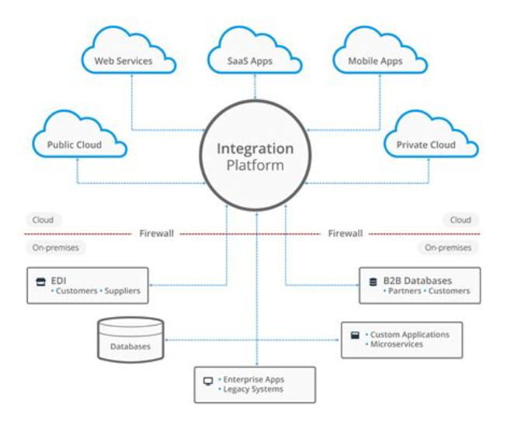
Integration with other systems and platforms
Integrating a student database management system with other systems and platforms is crucial for seamless operations. It allows for the exchange of data with learning management systems, financial systems, and other university platforms, ensuring comprehensive access and utilization of information.

Slide 7




Reporting and Analytics Capabilities
Data Visualization
Customizable Dashboards
Performance Metrics
Trend Analysis
Identify patterns and forecast future outcomes.
Visual representation of student performance and trends.
Personalized views for administrators and educators.
Measure student progress and identify areas for improvement.

Slide 8

Security Measures and Data Privacy in a Student Database Management System
Ensuring data security is essential for protecting students' sensitive information.
Implementing encryption, access controls, and regular security audits are crucial measures.
Additionally, strict adherence to data privacy regulations such as GDPR and FERPA is necessary.

Slide 9




Implementation and Training Considerations for a Student Database Management System
User Training
Plan comprehensive training sessions for administrators, faculty, and staff.
Data Migration Strategy
Develop a robust plan for migrating existing data to the new system seamlessly.
Technical Support
Establish a help desk and support team for addressing technical queries and issues.

Slide 10


Next Steps for Implementing a Student Database Management System
As we move forward with the implementation, it's crucial to focus on data migration, user training, and system testing. Additionally, creating a detailed timeline and allocation of resources will be essential for a successful deployment.
Considering the scale of the system, a phased rollout and continuous monitoring are recommended to ensure a smooth transition and effective use of the student database management system.

Slide 11
